Slide 1
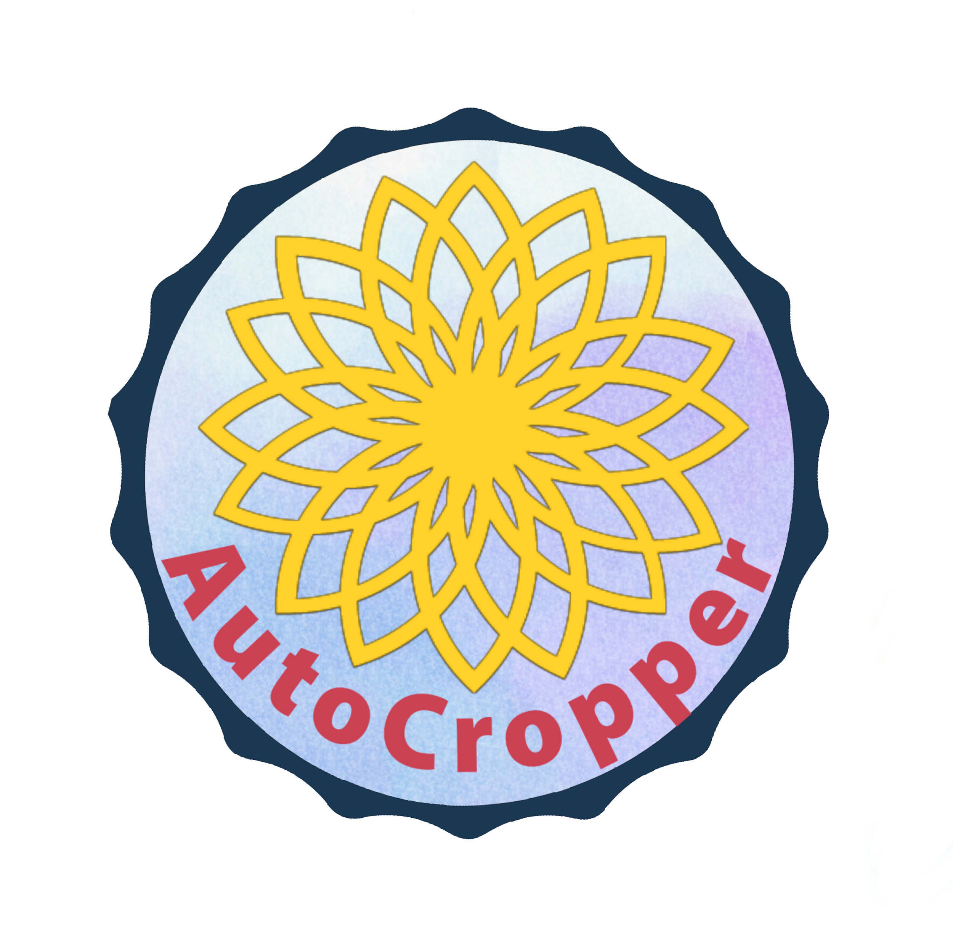
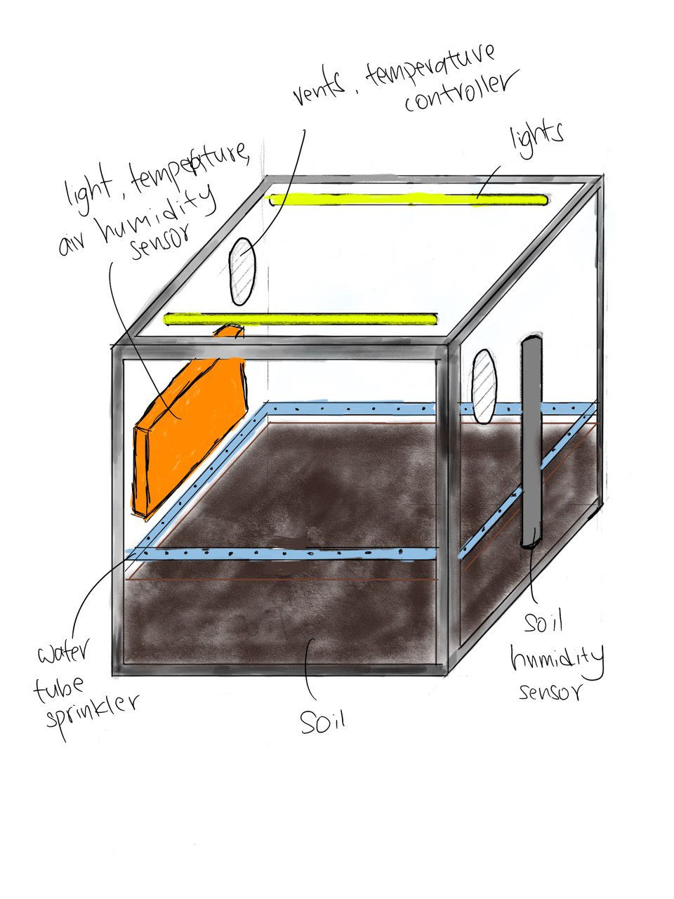
Team AutoCropper
To design an automated, computer controlled environment to enhance the productivity of crop growth and facilitate the sharing of information pertaining to crop growth amongst local producers.
Web Application
AutoCropper Device
Connection to the Autocropper device for users to provide the desired environmental conditions for crop cultivation
The AutoCropper device is designed to be remotely controlled from the web application.
Users can monitor the growth of the crops and modify the conditions at their own discretion.
Monitor active devices and alter the environmental conditions being used in the device whenever necessary
Save environmental conditions previously used and data pertaining to crop growth on a database for future reference
Browse the profiles of other users and easy accessibility to settings and conditions used by others to facilitate sharing of information between local producers
Connect to AutoCropper Device via the Web application
Access a variety of features provided on the web application
Provides the desired conditions for crop growth in a controlled environment
Monitor the crops in the device and remotely adjust the environmental conditions
Input desired environmental conditions to be used for crop growth in the device
A platform for users to interact with other local producers in the field of agriculture
Temperature, water content, light intensity and humidity
Conditions are regulated using various sensors in the device

